Slide 1
Session 2020-21 CSTE-3101 Communication Engineering

Slide 2
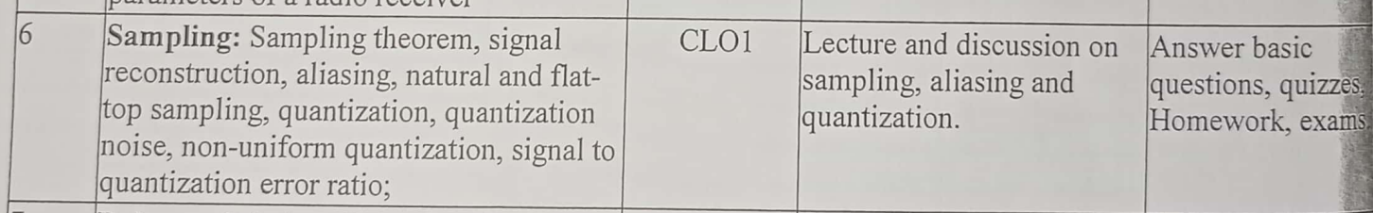

Slide 3
Sampling

Slide 4
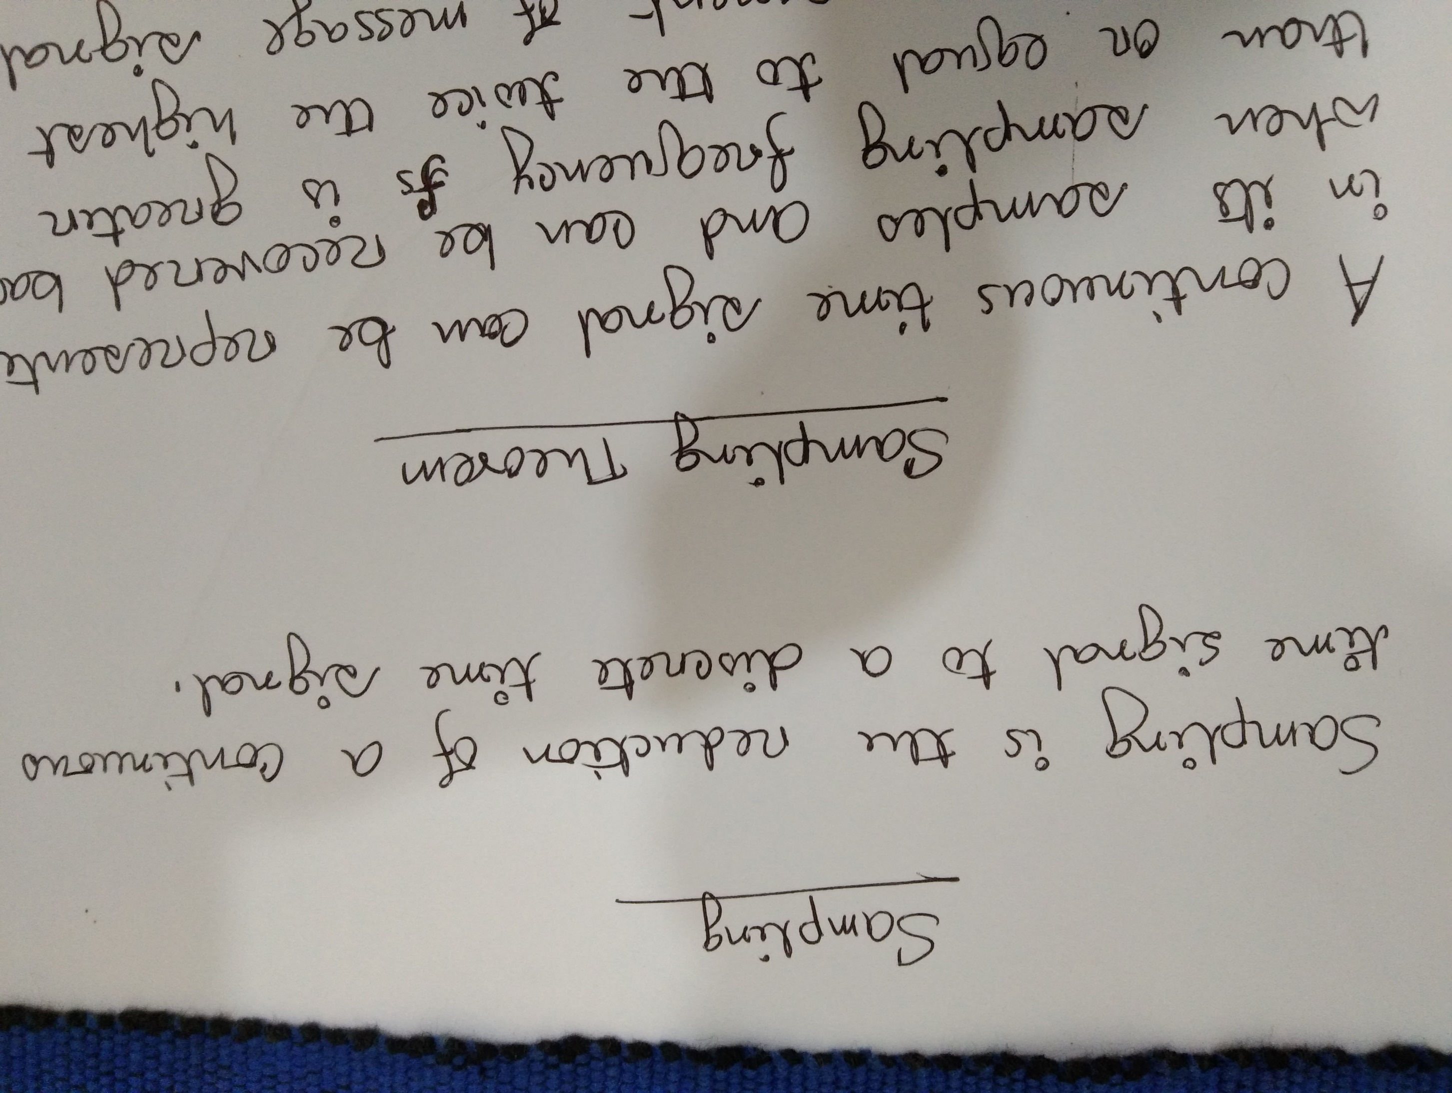

Slide 5
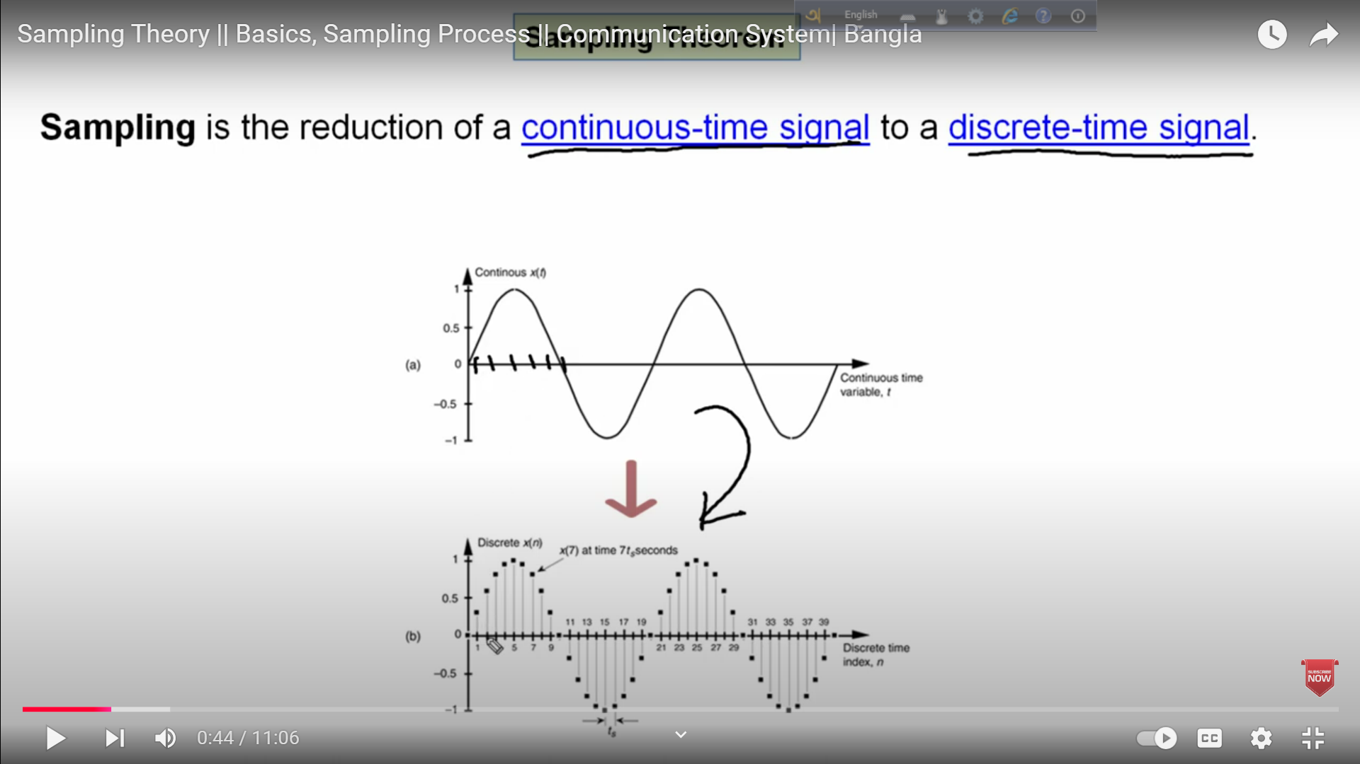

Slide 6
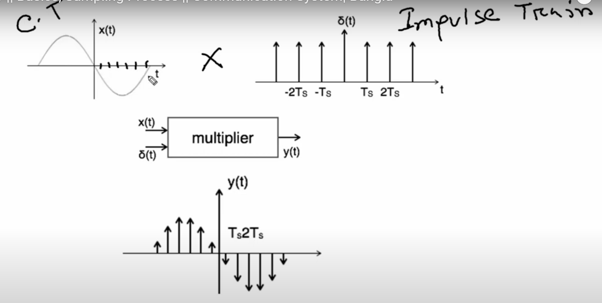
Sampling Procedure

Slide 7
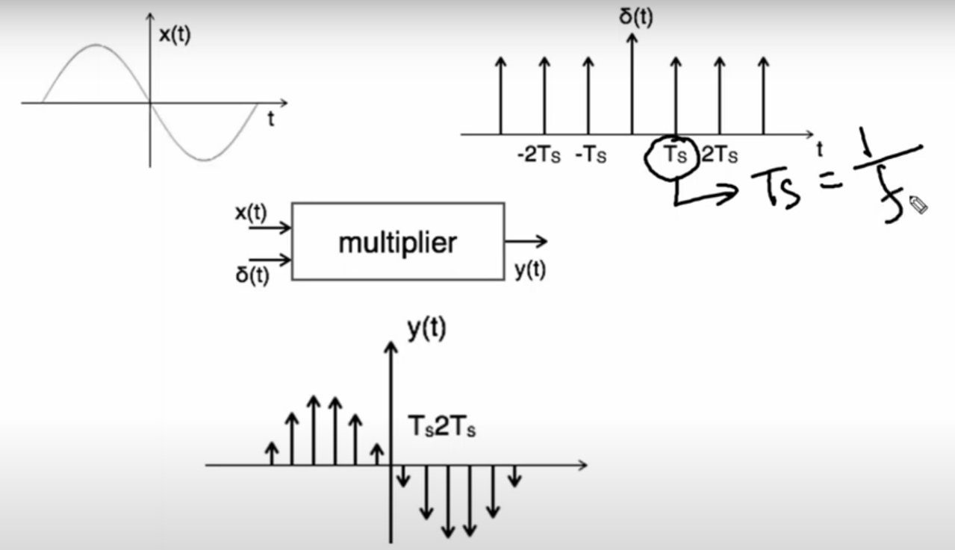
Sampling Frequency

Slide 8
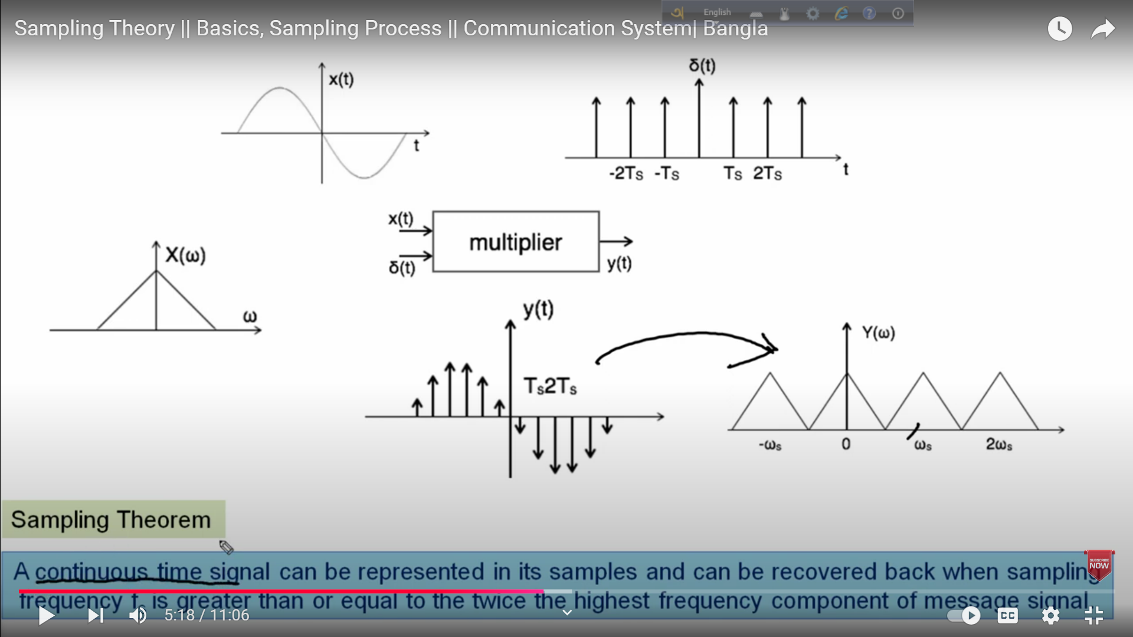

Slide 9
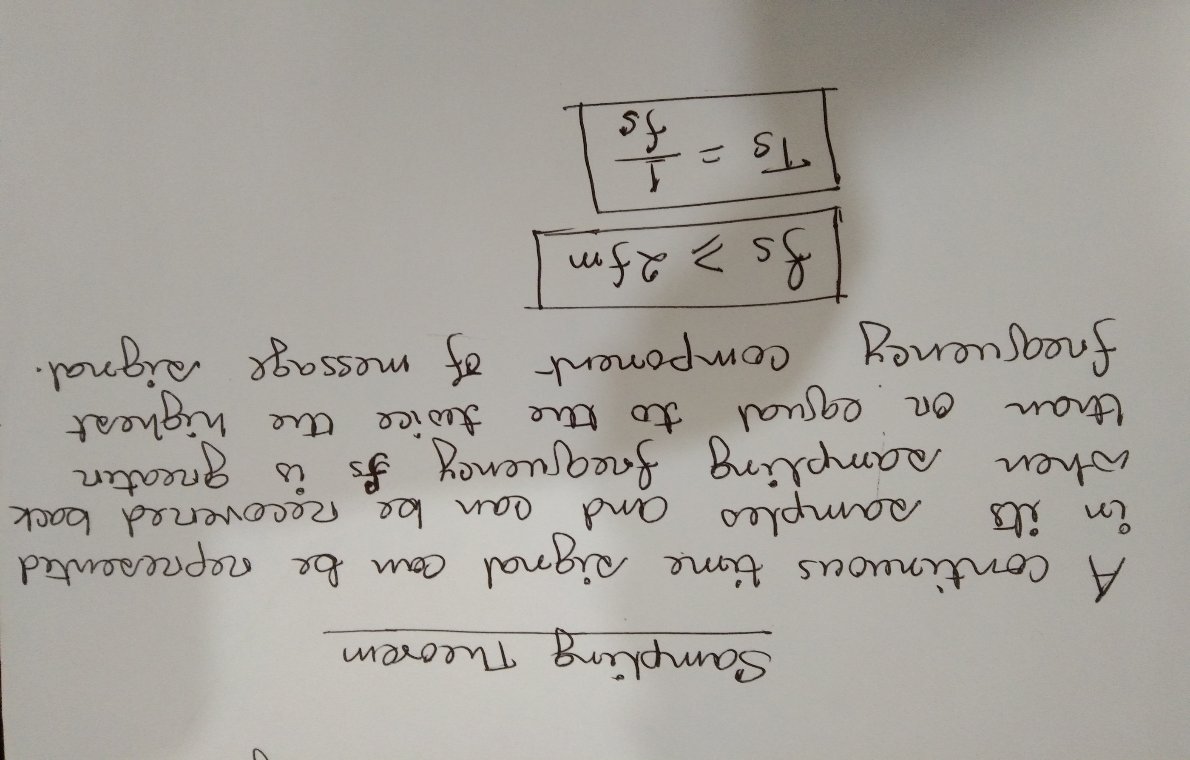
Sampling theorem

Slide 10
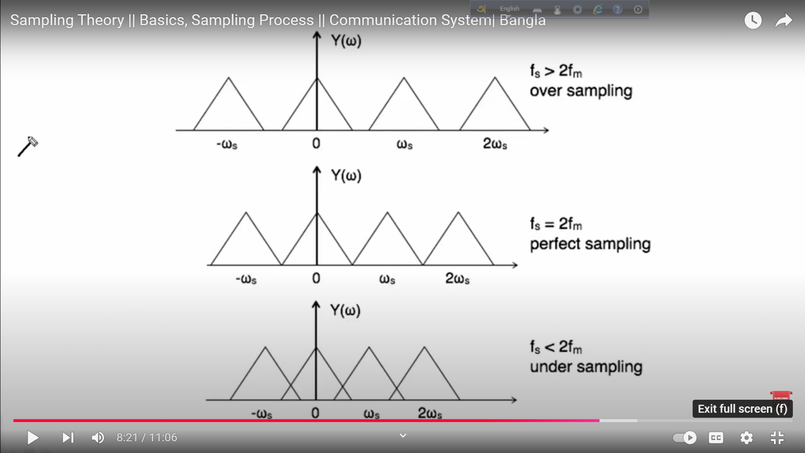

Slide 11
Quantization

Slide 12
Quantization
Quantization is the process in which continuous amplitude (analog) signals is converted into discrete amplitude (digital) signals.

Slide 13
Quantization Process

Slide 14
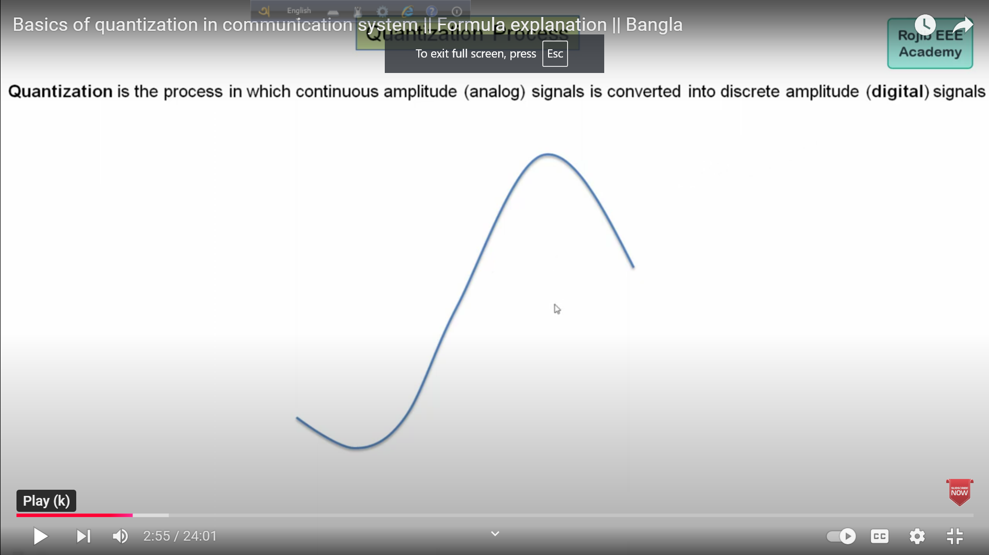
Continuous Amplitude Signal

Slide 15
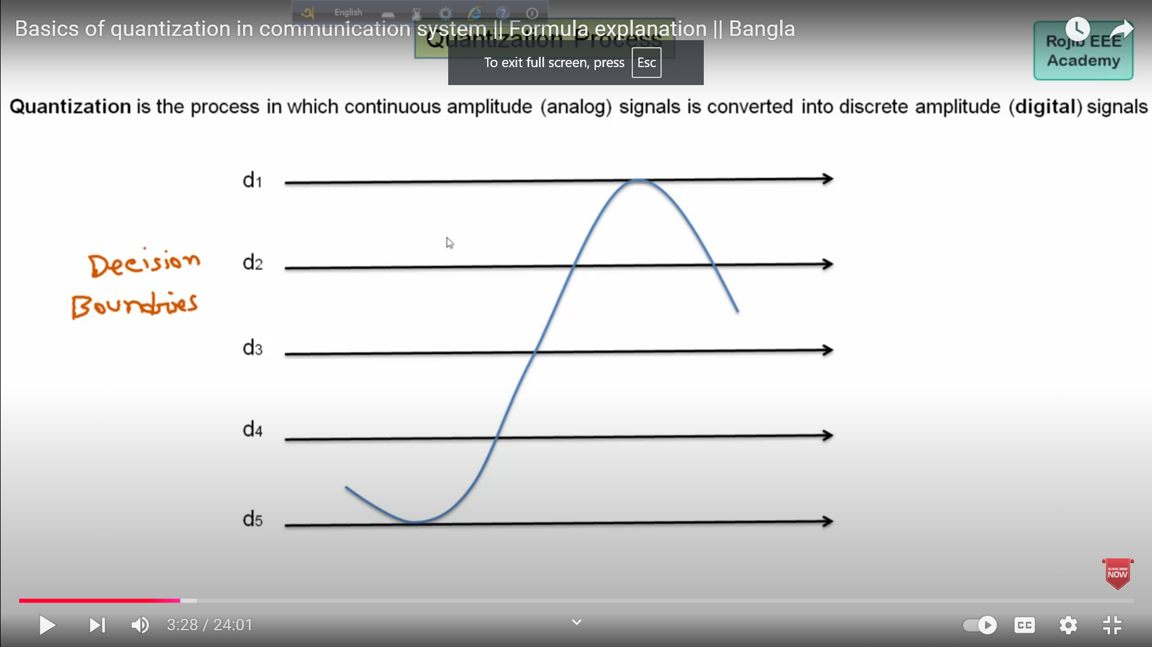
Decision Boundaries

Slide 16
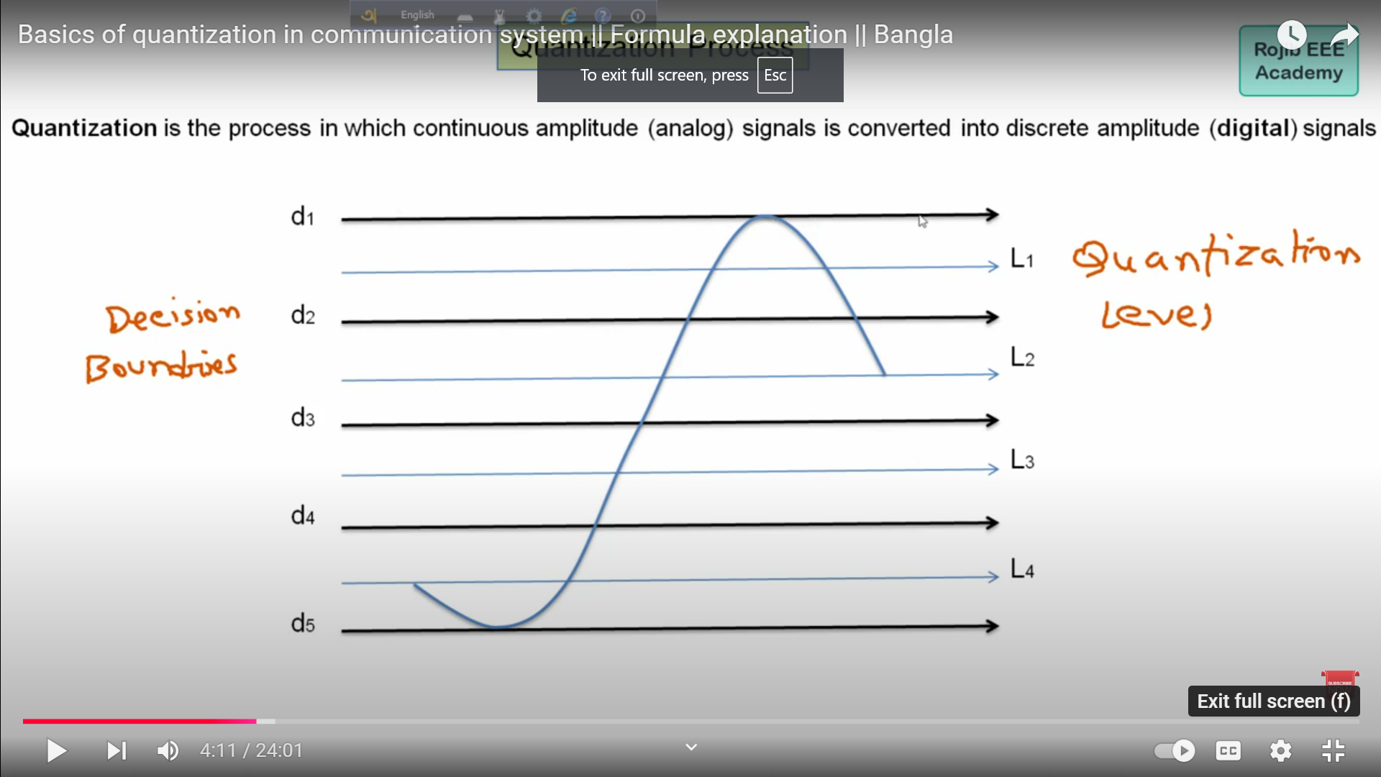
Quantization Level

Slide 17
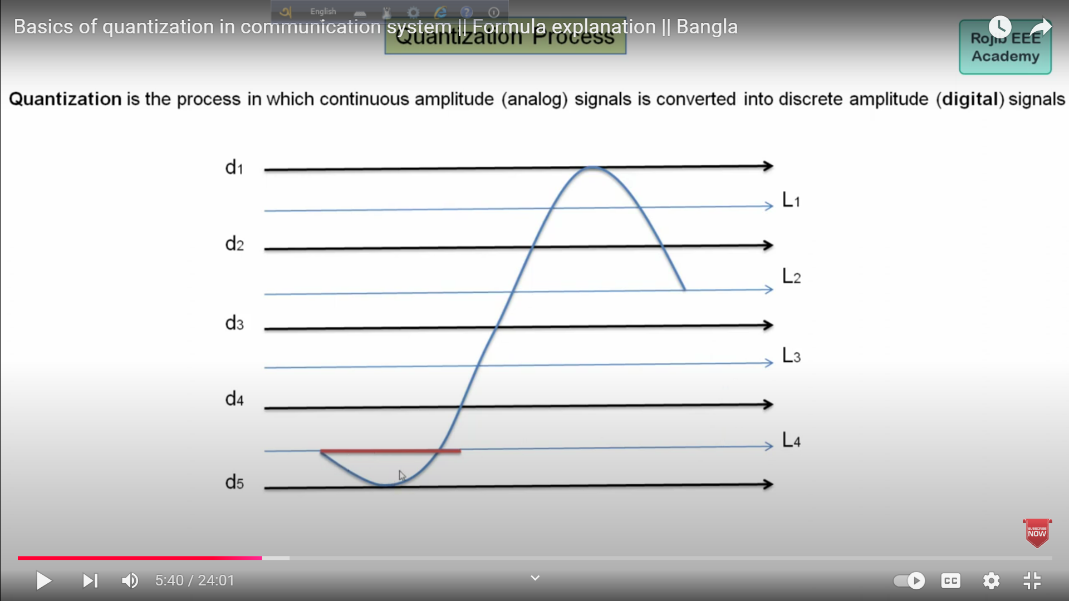

Slide 18
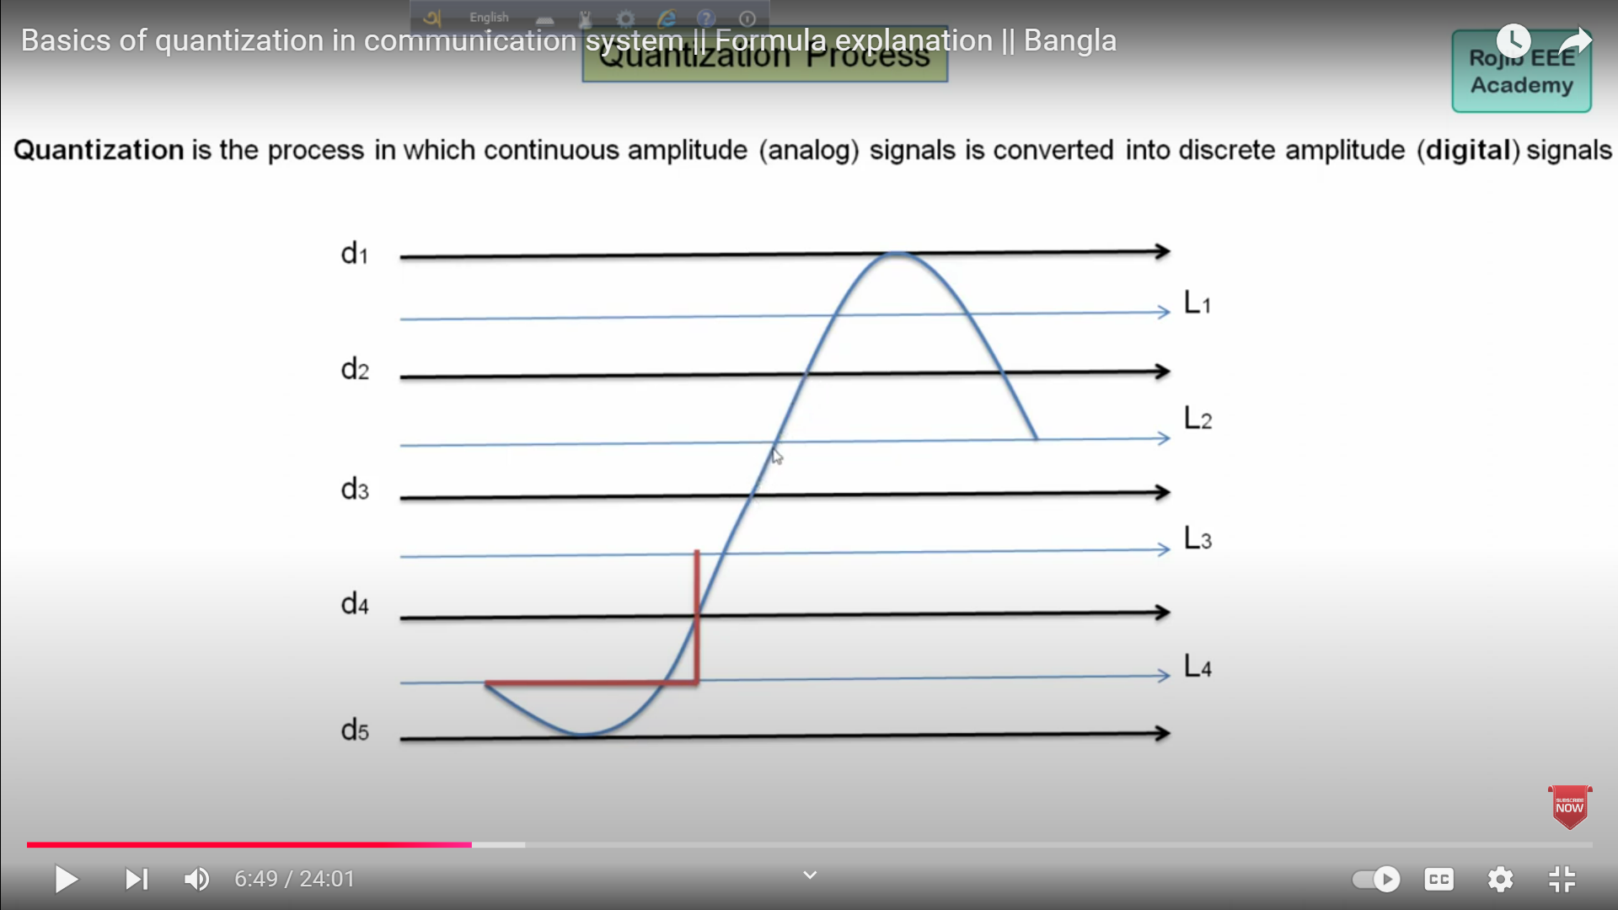

Slide 19
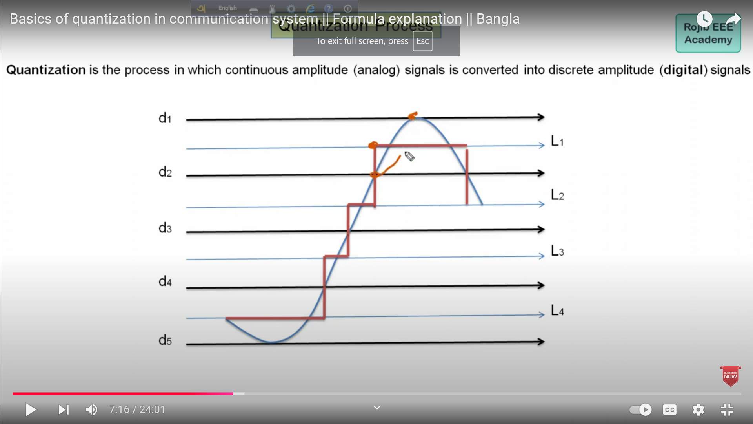

Slide 20
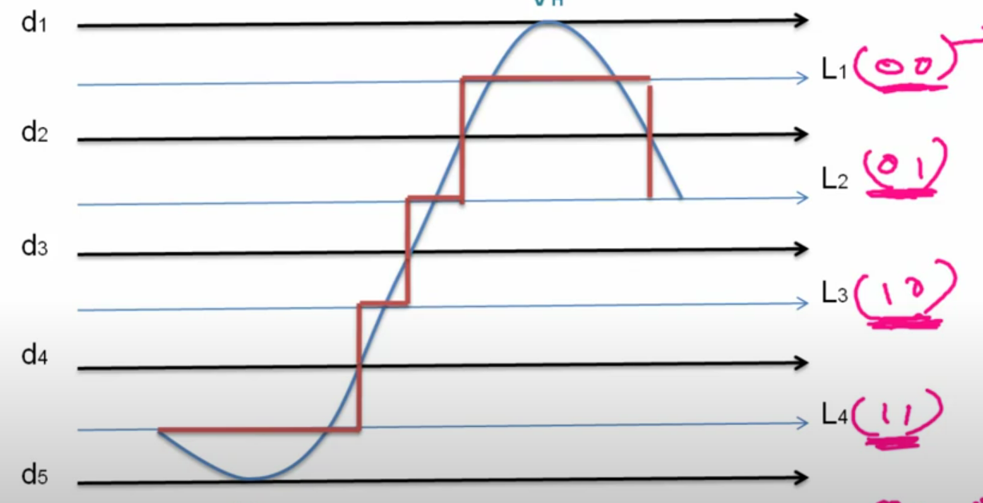
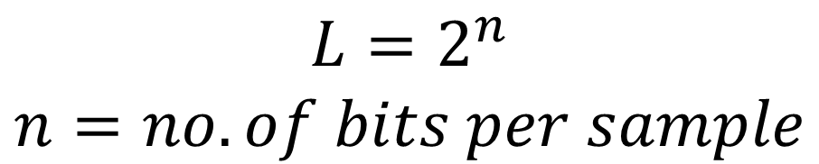
$$L=2^{n}$$
$$n=no. of bits per sample$$

Slide 21
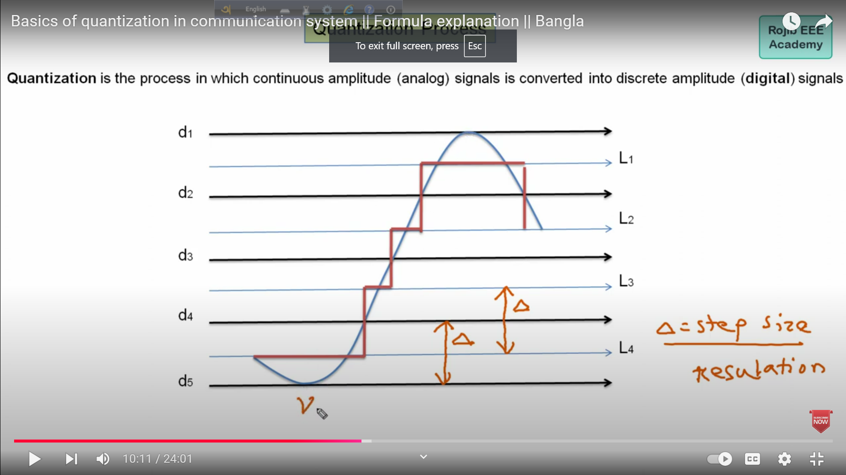
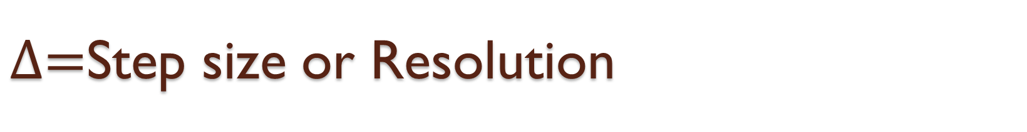
$∆=$Step size or Resolution

Slide 22
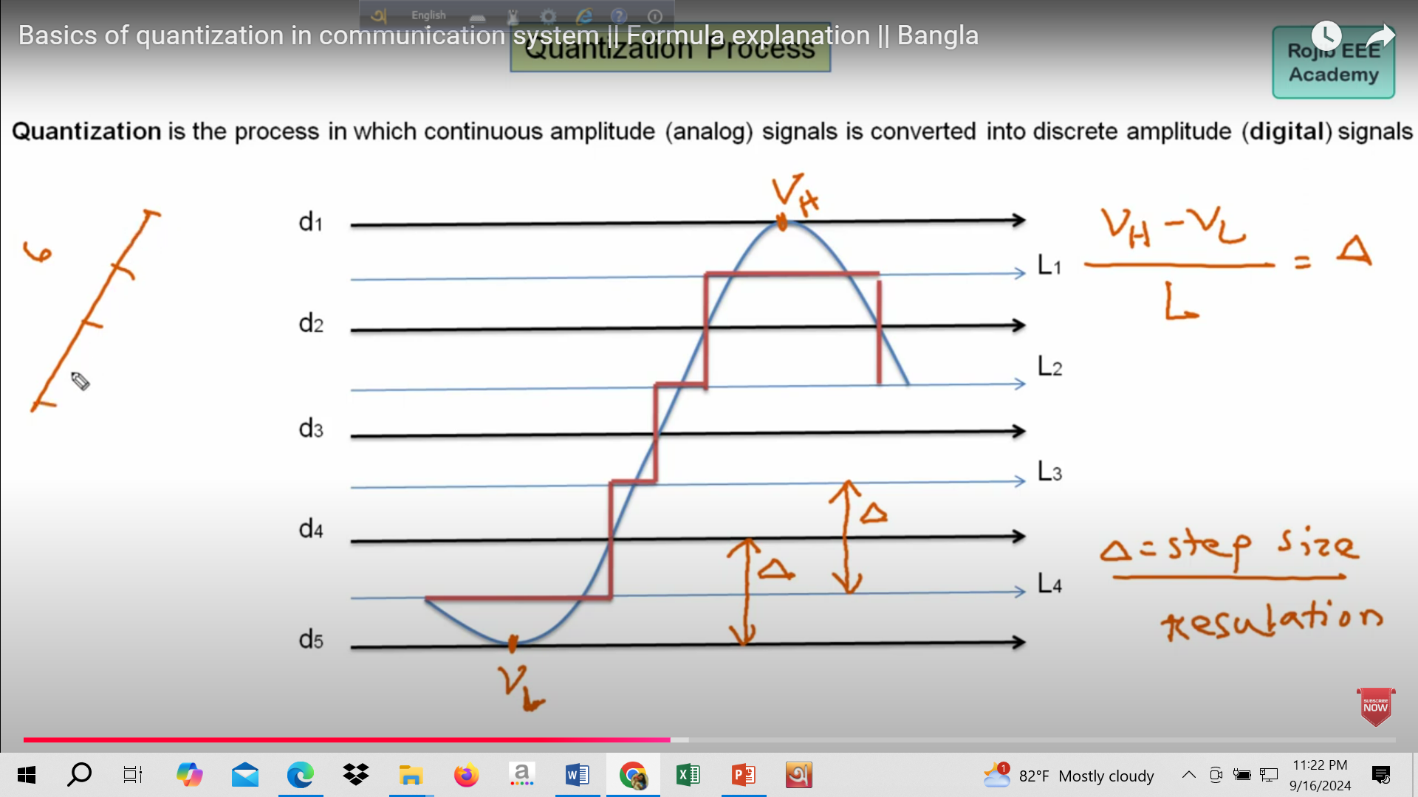
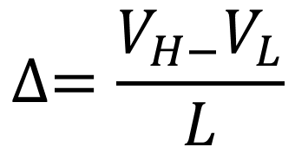
$$∆=\frac{V_{H−}V_{L}}{L}$$

Slide 23
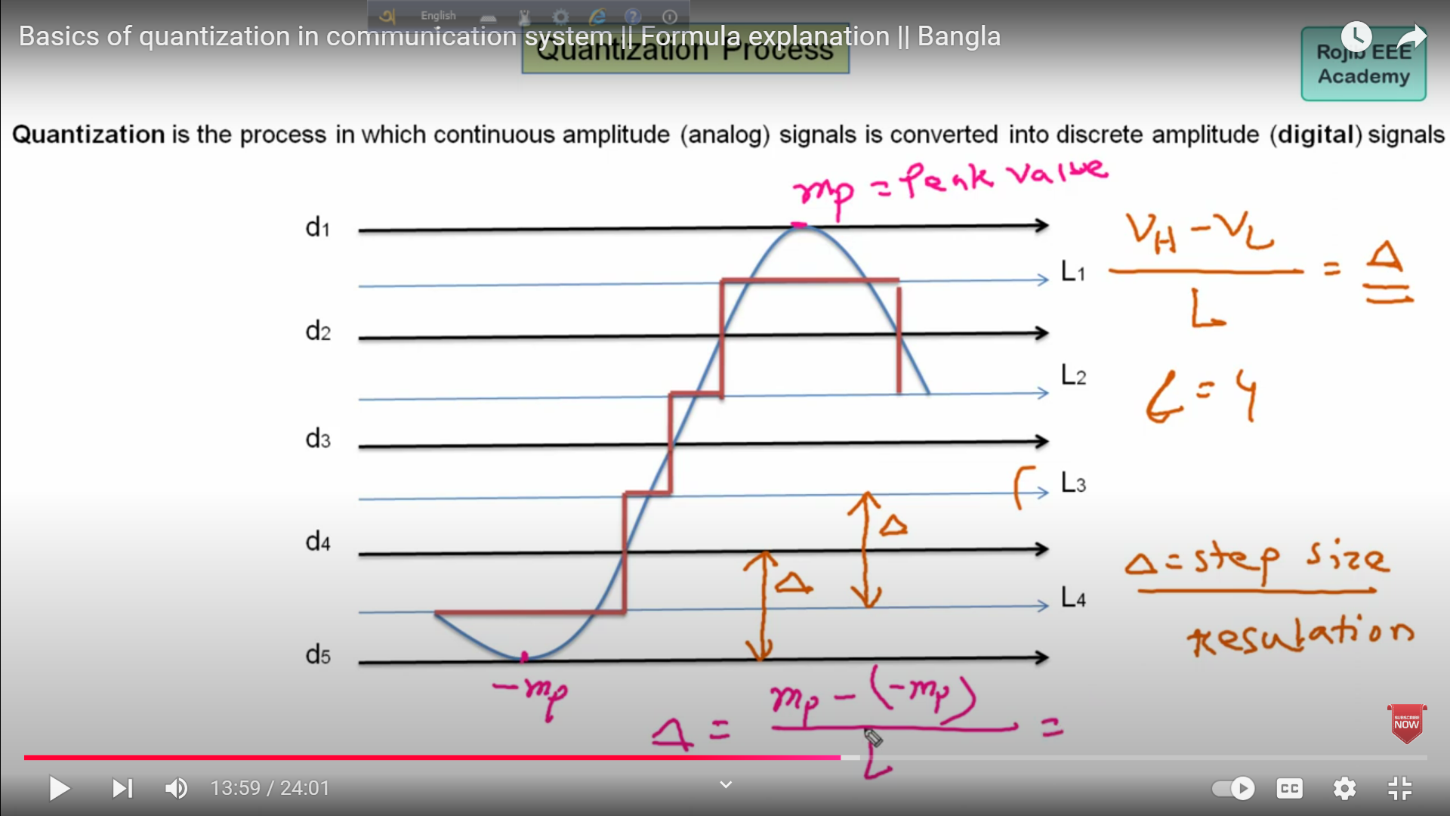
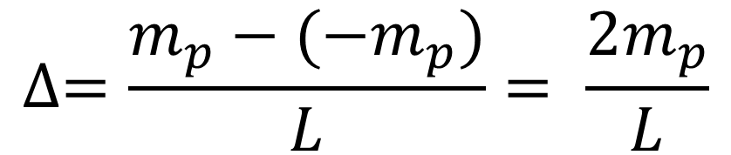
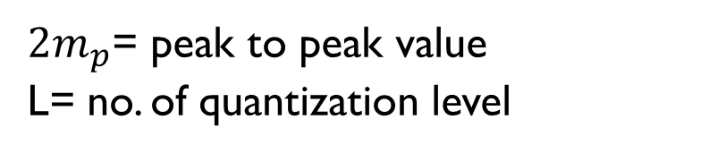
$$∆=\frac{m_{p}−({−m}_{p})}{L}= \frac{2m_{p}}{L}$$
$2m_{p}$= peak to peak value
L= no. of quantization level

Slide 24
Quantization Error

Slide 25
Quantization Error
The difference between an input and output of a quantizer is known as quantization error.

Slide 26
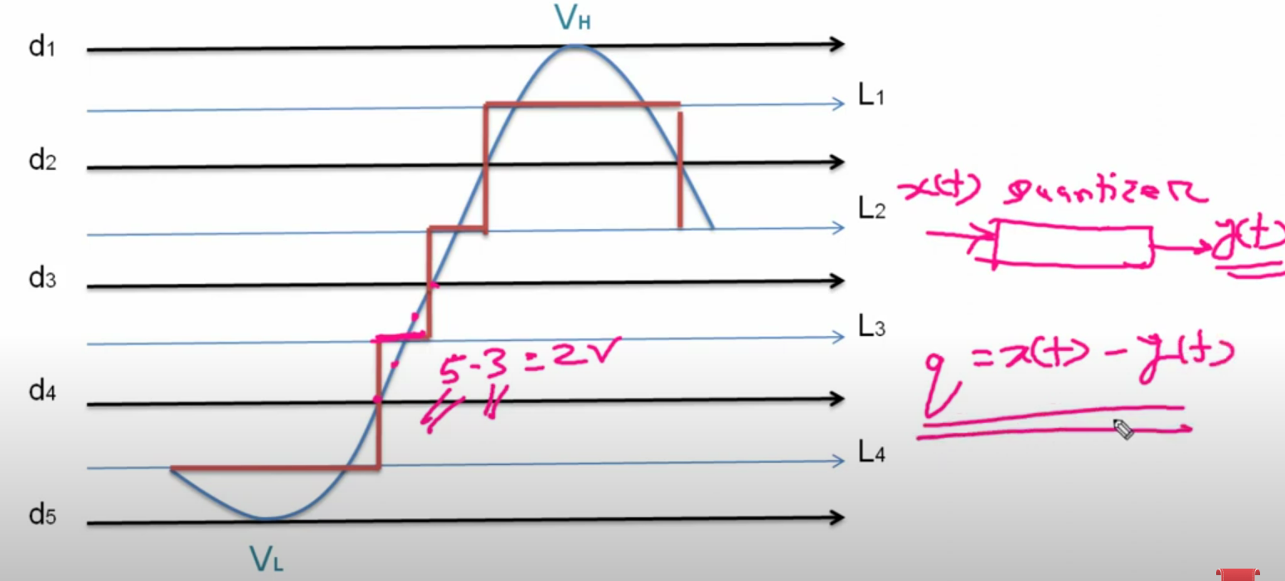

Slide 27
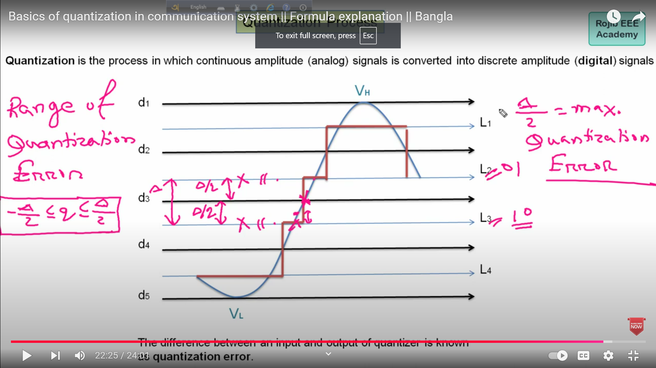
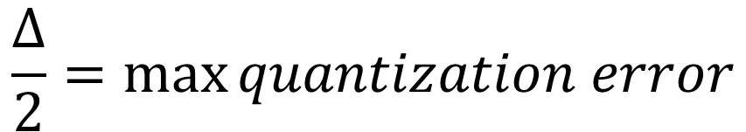
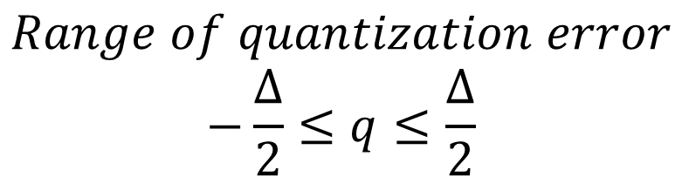
$$\frac{∆}{2}=\max{quantization error}$$
$$Range of quantization error$$
$$−\frac{∆}{2}≤q≤\frac{∆}{2}$$

Slide 28
PCM

Slide 29
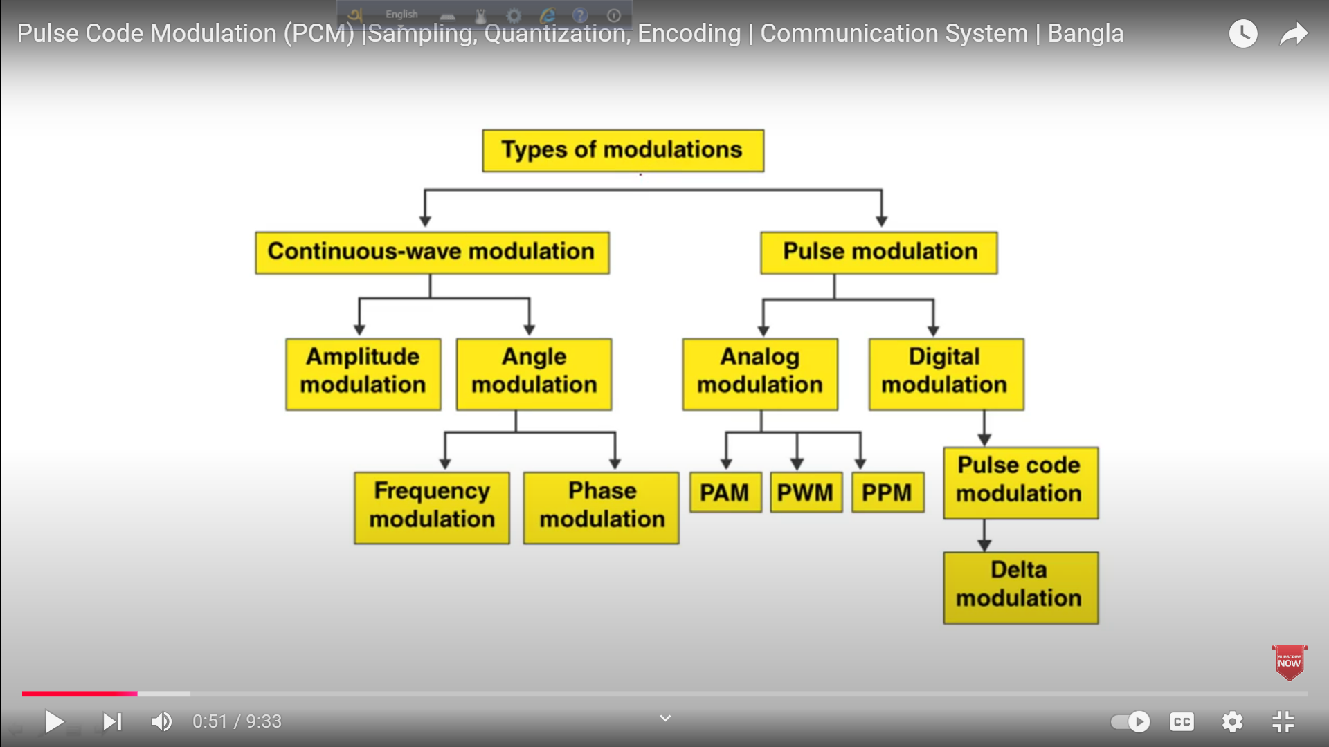

Slide 30
Block Diagram of PCM

Slide 31
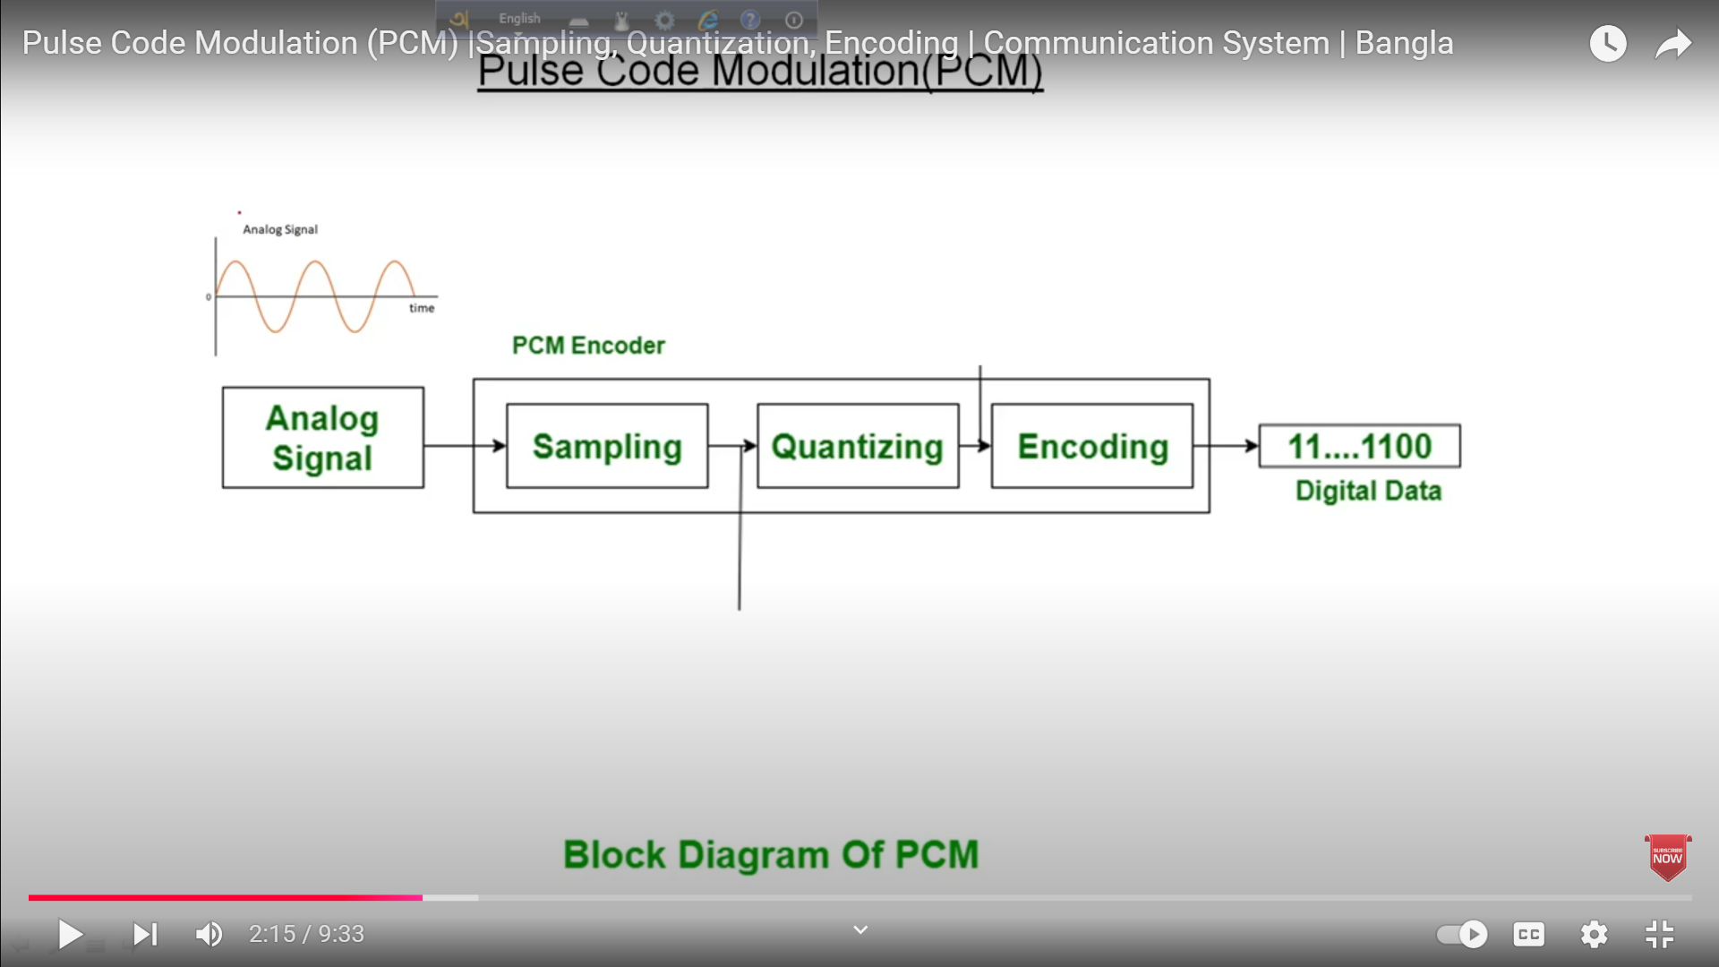

Slide 32
Instead of Antenna PCM technique use Wire to transmit digital data.

Slide 33
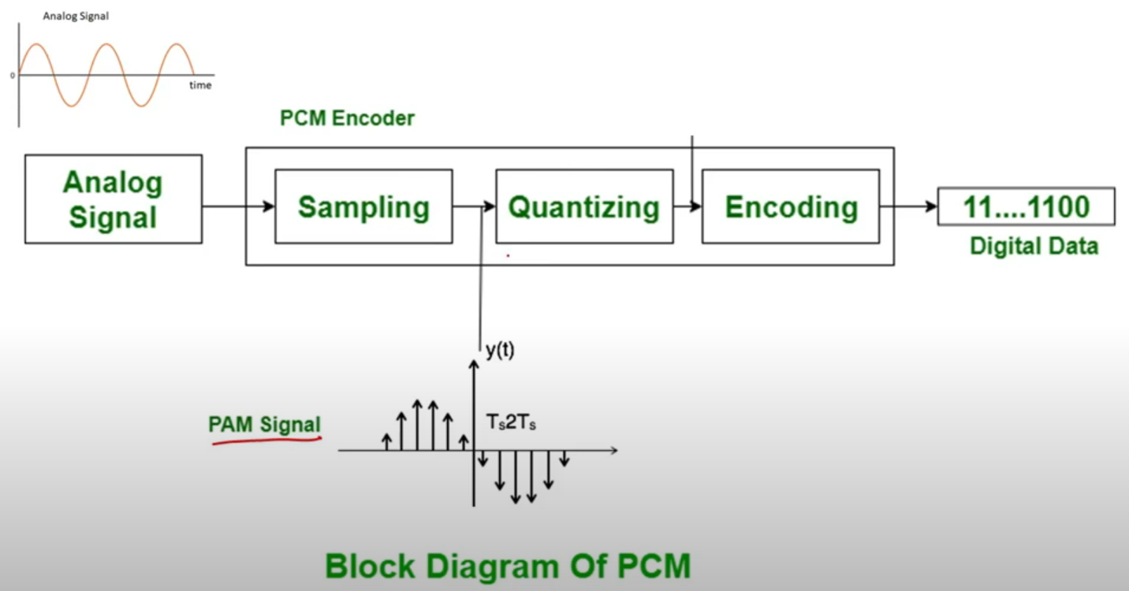

Slide 34
